Slide 1
Pitch Perfect
SIGHT-READING
Start

Slide 2

Pitch Perfect
SIGHT-READING
Start

Slide 3
Unit 1: Introduction to Treble Clef
Start
Start

Slide 4

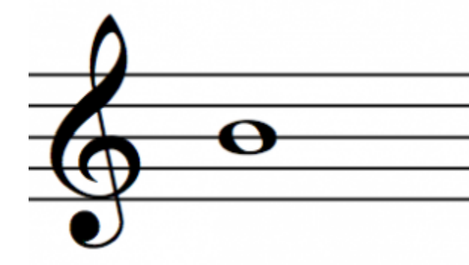
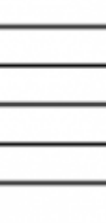


Submit
C
C#
Db
D#
Eb
F#
Gb
G#
Ab
A#
Bb
D
E
F
G
A
B

Slide 5
Submit
C
C#
Db
D#
Eb
F#
Gb
G#
Ab
A#
Bb
D
E
F
G
A
B

Slide 6
Submit
C
C#
Db
D#
Eb
F#
Gb
G#
Ab
A#
Bb
D
E
F
G
A
B

Slide 7
b
Submit
C
C#
Db
D#
Eb
F#
Gb
G#
Ab
A#
Bb
D
E
F
G
A
B

Slide 8
Submit
C
C#
Db
D#
Eb
F#
Gb
G#
Ab
A#
Bb
D
E
F
G
A
B

Slide 9
Submit
C
C#
Db
D#
Eb
F#
Gb
G#
Ab
A#
Bb
D
E
F
G
A
B

Slide 10
Submit
C
C#
Db
D#
Eb
F#
Gb
G#
Ab
A#
Bb
D
E
F
G
A
B

Slide 11
Lesson Complete
Back to Menu
Next Lesson

Slide 12
Unit 1: Introduction to Treble Clef
Start

